Slide 1
How to use this resource
This presentation is a tool to facilitate conversations about impact investing for charitable foundations.
It seeks to inform stakeholders on what impact investing is, bust myths that present an obstacle to embarking on an impact investing strategy, highlight key arguments for impact investing for foundations, and provide practical steps on how to get started. It closes with prompt questions to stimulate discussion.
This presentation contains detailed speaker notes and is designed to be customised and tailored to the individual needs of charitable foundations and family offices. Please do delete or add content as is useful to you and your organisation.
While the presentation has been written so that any individual could deliver it, the Impact Investing Institute is also happy to speak to its contents. Should you wish one of the Institute team to deliver a version of this presentation please be in touch with sarah.teacher@impactinvest.org.uk

Slide 2

Investing with impact
in the endowment
Why do it and how to get started

Slide 3
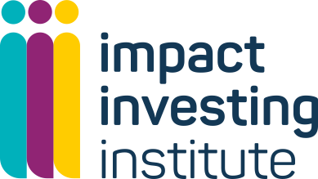
Session agenda
[Insert logo here]
What is impact investing?
Myth-busting: can charities invest their endowments with impact?
How could impact investing help us as a foundation?
Getting started: impact investing in the endowment
What could impact investing look like for our foundation?
Annex. About the Impact Investing Institute
www.impactinvest.org.uk
Notes:
Today we will cover the following and leave some time for questions at the end:
What is impact investing?
Myth-busting: can charities invest their endowments with impact?
How could impact investing help you as a foundation?
Getting started impact investing in the endowment
What could impact investing look like for your foundation?

Slide 4
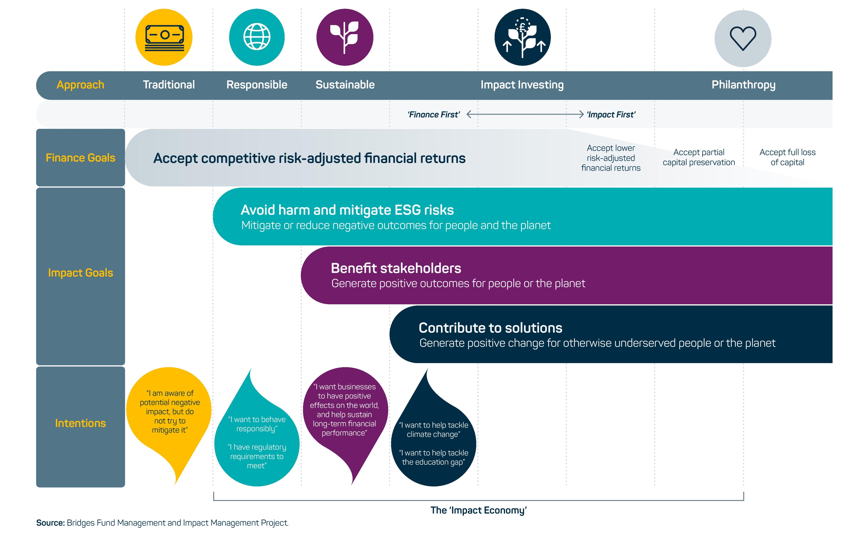
What is impact investing?
[Insert logo here]
“investments made with an explicit intention to generate positive, measurable social and environmental impact alongside a financial return.”
Global Impact Investing Network
www.impactinvest.org.uk
Notes:
Impact investing’ is the original term formalised in 2007/08 by a cluster of foundations gathered under the aegis of the Rockefeller Foundation for seeking to combine financial return with delivering public benefit. Today the impact investing field has largely coalesced around the Global Impact Investing Network (GIIN)’s, definition of impact investments as “investments made with an explicit intention to generate positive, measurable social and environmental impact alongside a financial return.”
Impact investment sits at the middle/higher end of a spectrum of investment approaches where the balance between targeting financial goals and outcome goals progressively shifts. This spectrum ranges from traditional investing that focuses purely on financial return, through to responsible and sustainable investing (the world of environmental, social and governance, or ESG, investing) and on to impact investing, social investment and philanthropy. Bridges Fund Management detailed this spectrum in a short paper in 2017, graphically plotting the different categories of investment approach in a visual that we’ve included here.
Impact investment goes beyond responsible and sustainable approaches and is ultimately about contributing solutions. It provides capital to help solve social and environmental problems rather than just manage the risks associated with those problems. Impact investing builds on sustainable investing in three ways:
Intentionality: Investors seek to contribute to the well-being of people and the planet while receiving a financial return. Their approach is not just about risk mitigation, it is the investor seeking a specified social or environmental outcome, which can range from decreasing carbon emissions to increasing decent local jobs in a given place. Impact intentionality means establishing an impact goal for an investment before it is made, including how its relative success or failure will be measured.
Measurability: Impact investing seeks to manage, measure and report on social and environmental outcomes with rigor and consistency. Measurement holds the investor accountable to their impact intention. Transparent and comparable measurement and reporting is also key to assessing the effectiveness of a strategy relative to its peers.
Additionality: Additionality asks that a given impact investment makes more of a difference than a “business-as- usual” approach. An impact investment should be additive: ideally, it should make an impact occur that wouldn’t have happened had the investment not been made.
Impact investing is therefore an approach, not an asset class, and is a broad church too: it can be delivered in both public and private markets; it may aim for risk-adjusted market rate returns or have a concessionary target (i.e where financial return is potentially sacrificed to achieve a social or environmental benefit); and be applied to the majority of impact goals that a foundation might seek to deliver against.
Impact-driven investment is a description used by the Association of Charitable Foundations (ACF) to describe the risk- adjusted market rate return wing of the impact investing market – the kind of activity that would be most fitting for the endowment. ACF defines “impact-driven investment” as aiming to “balance financial returns with strong positive outcomes for marginalised people and/or the planet”. In the US this is also often called Mission Related Investment, or MRI.
Social investment or impact-first investment (as it is termed by ACF), is an integral part of impact investing’s broad church. Within the UK sector, when the returns targeted are below market return the approach is typically described as social investment. This might comprise loans to charities and social enterprises for example, where repayable finance is central but seeking a market rate return could undermine the creation of impact. In the US this is also often called Programme Related Investment. This kind of activity seldom takes place in the endowment as its return profile is too low.

Slide 5

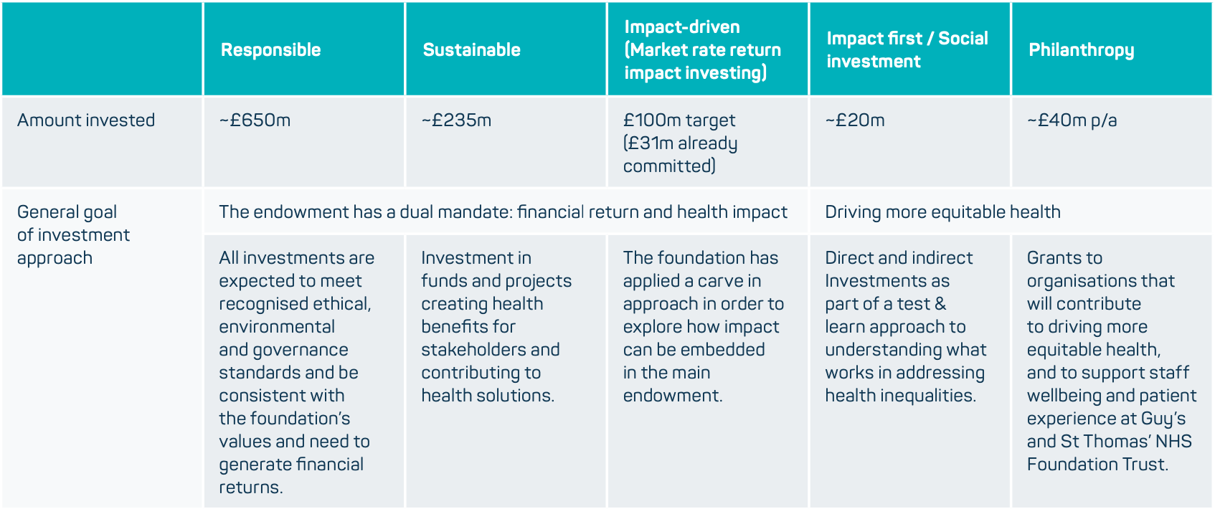
“Impact investments are investments made with an explicit intention to generate positive, measurable social and environmental impact alongside a financial return”
Notes:
To give colour to the spectrum with an example!
This slide depicts a highly simplified picture of Guy’s and St Thomas’ mapped along the spectrum of capital.
Guy’s has a mission to drive more equitable health in London – particularly in Southwark and Lambeth
Until recently it focused most of its attention on the two columns on the RHS:
Its £40m philanthropy allocation on the RHS – optimising its grants.
And it’s 20m impact first social investment strategy, targeting capital preservation or more
But as of 2018 it started to experiment more actively with the endowment wing of its £1bn AUM, ultimately last year committing to shift the entire portfolio to deliver health impacts over time.
The middle yellow column is the one we’re talking about today: “impact driven” investing or “mission related investing”. This is activity in the endowment that is delivering positive impacts and risk-adjusted market rate return.
Guy’s started with a 5% allocation to impact driven strategies in 2018. And today, on that journey to £1bn “total impact” they have agreed to deliver £100m to impact driven strategies in the next 5 years – with 31m already committed.
These are risk-adjusted market rate return opportunities that are also driving health outcomes spread across 9 funds in focus sectors such as healthcare innovation, healthcare service delivery and social determinants of health including housing for vulnerable people, social outcomes contracts, and technology supporting health access.
So that’s the zone, that’s the opportunity, and we think it could be interesting to a multiplicity of foundations.

Slide 6

Myth Busting
Legality
Financial returns
Product diversity
Notes:
Before getting into the reasons why we think impact investing in the endowment could be interesting for charitable foundation endowments, there are 3 impact investing market myths to debunk that commonly lead people to hesitate before creating an impact investing strategy.
These are often anchored in an outdated sense of where the market is at – so hopefully by allying them right at the top I can get you into the more interesting space of thinking about the relevance of this agenda for [Insert foundation name here]

Slide 7

Myth 1. Impact investing is legally at odds with trustees’ duties
[Insert logo here]
Endowed charities are legally permitted to make impact investments.
Decisive ruling in in 2022, Butler-Sloss v Charity Commission
Charities can seek overall returns, i.e. financial and social returns, from their investments
More detail can be found in the Impact Investing Institute legal paper Can charities invest with impact?
www.impactinvest.org.uk
Notes:
Myth one: the idea that impact investing is at odds with trustees’ duties:
Endowed charities are legally permitted to make impact investments. Charities should feel comfortable with the idea that they can legally make impact investments and there are many charities in the UK and globally who are already doing so.
With the judgement in the case of Butler-Sloss v Charity Commission, a decisive step has been taken towards dispelling the myth that impact investing is incompatible with trustees fiduciary duties.
This judgement empowers trustees to help support this essential cause, considering the social, as well as the environmental, impacts of their investments.
Above all, the judgement resolves the paradoxical situation of foundations’ investments contradicting the aims of their charitable work.
When developing an investment strategy, a helpful question to guide charity trustees is: what approach to investment is most likely to advance your charitable purposes over time?
Traditionally, answering this question has been exclusionary – that is, operating a policy of exclusions for certain forms of potentially harmful investments that directly conflict with a charity's purposes – but in considering whether an investment is in the best interests of a charity, it might be prudent for charity trustees to consider the social or environmental impact of an investment more extensively.
More detail can be found in our legal paper Can charities invest with impact which was co-authored with Bates Wells and Herbert Smith Freehills and reviewed by Farrar & Co. and BDB Pitmans.

Slide 8


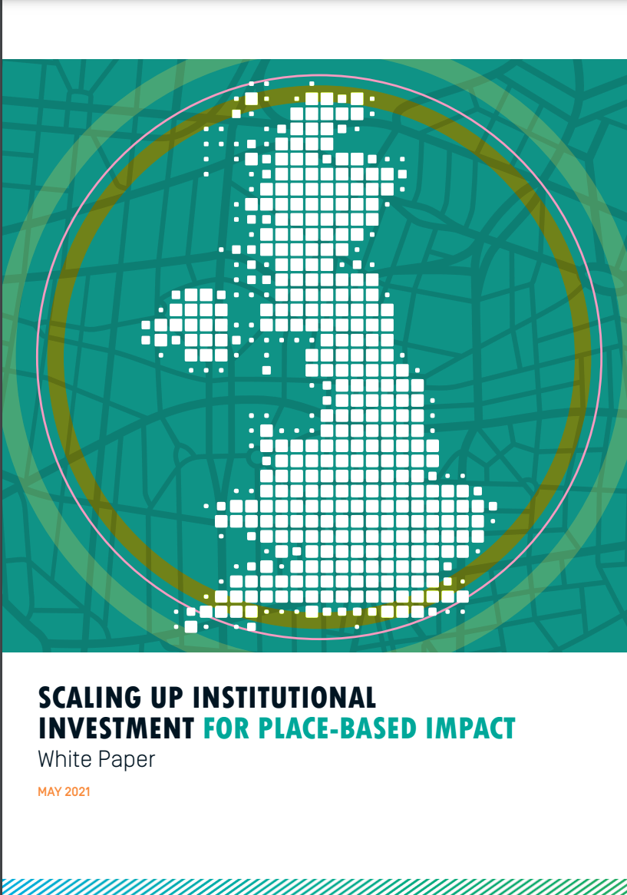
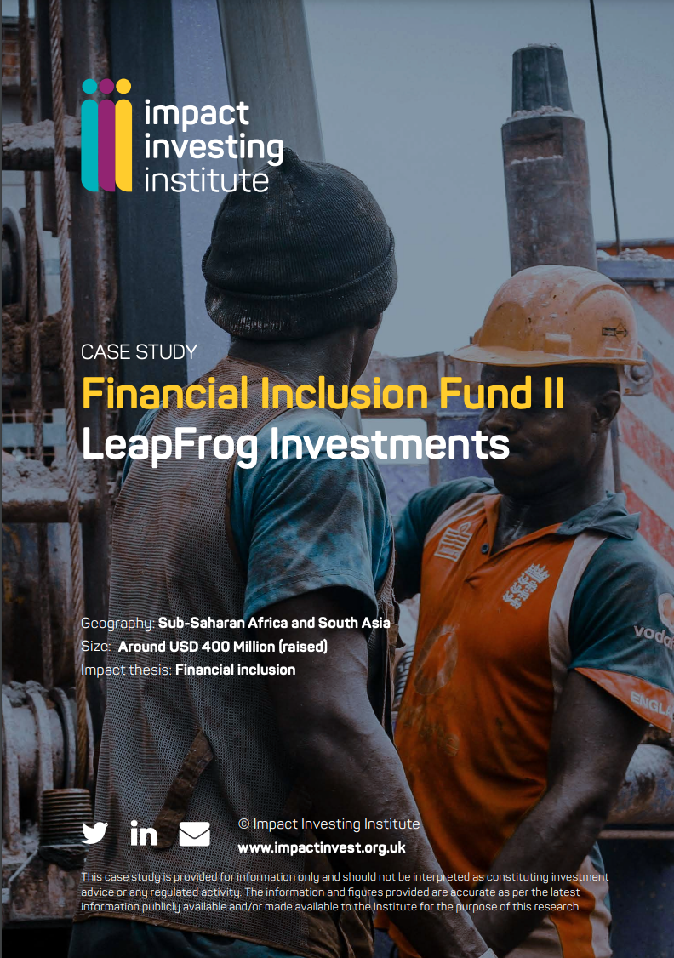
Myth 2. Impact investing yields concessionary returns
[Insert logo here]
A growing body of evidence has established that impact investing does not mean sacrificing financial returns
Approximately 90% of respondents to the Impact Investing Institute survey on the size of the UK impact investing market reported that returns were either in line or exceeded their targets
www.impactinvest.org.uk
Notes:
Myth two: Impact investing is incompatible with market rate financial returns:
The Institute has a growing evidence base that rebuffs this pernicious myth. We have an extensive set of case studies in affordable housing, emerging markets, investments that benefit place (SME investing, urban regeneration, renewable energy, infrastructure) that highlights that is not the case.
We just released our sizing of the UK impact investing market. In the survey related to the study of 40 market participants:
90% reported that 2020 returns were either in line with or exceeded their targets.
This year Pensions for Purpose released a survey of £150bn AUM of pension fund assets showed that half of them had impact assets in their portfolio and the average pension fund in their study had a 4.87% allocation to impact. The market is here. If pensions are playing a role with their stringent fiduciary duties to deliver market rate return, so can you.

Slide 9
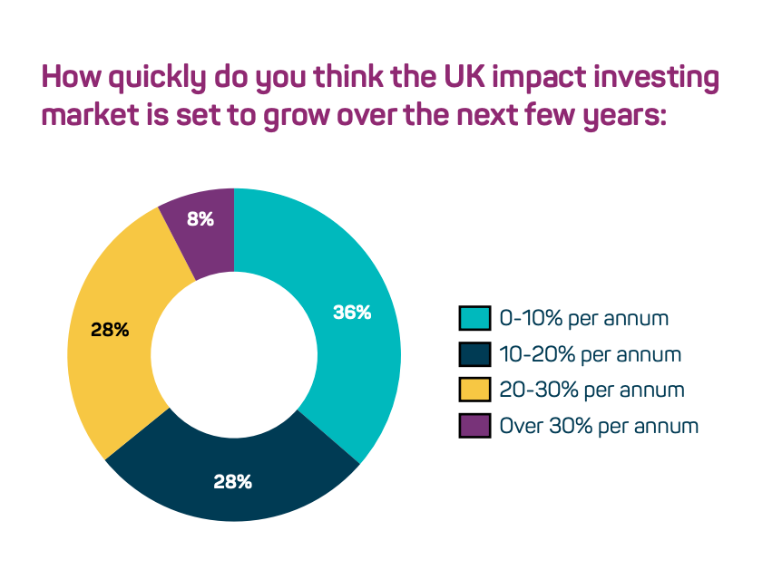
Myth 3. Product selection is small and only in private markets
[Insert logo here]
£58bn
AUM
2020 UK impact investing market size
£100bn
AUM
within 5 years
www.impactinvest.org.uk
Notes:
Myth 3: Product selection is small and only in private markets
The Institute’s sizing of the UK impact investing market documents the 2020 the UK market was £58bn. The survey suggested that funds allocated to impact are predicted to at least double in the next five years to £100bn.
While it is true that impact investing is still only 1% of the mainstream capital markets – as is attested by its growth product is growing exponentially and in public markets too. In the latter - One recent example is the - Schroder BSC Social Impact Trust – alisted vehicle, open-ended, highly impactful – already invested in specialist housing for survivors of domestic violence.
A key area of growth and an important option for impact investors is the emergence of green, social, sustainable and sustainability-linked (GSSS) bonds too. In 2020 according to figures from the Environmental Finance Bond Database, total GSSS issuance crossed $600bn – nearly double the $326bn issued in 2019.

Slide 10

How could impact investing help us?
More capital driving positive impacts and public benefit outcomes
Unlock new strategies to help meet our mission
Reputational considerations
Catalysing change in other investors and in the capital markets more broadly
Improving the long-term effectiveness and accountability of capital

Slide 11
1. More capital driving positive impacts and public benefit outcomes
[Insert logo here]
£40m
Yearly grant
spend
Planet vs. the sun: increase the assets contributing to the foundation's mission
£ return means that an original sum can be reapplied to social purpose, compounding the impact that any £ can have over time
£1b
Endowment invested
in capital markets
“the reality is [for UK foundations] that most of our assets are invisible, even to us: staff tasked with the delivery of impact are sometimes focused on as little as 4% of the foundation’s assets, while the remaining 96% is outsourced to external non-impact specialist investment managers."
www.impactinvest.org.uk
Notes:
The first is simply More capital driving positive impacts and public benefit outcomes
One foundation described this beautifully:
We think of the size differential between grant-making and the assets invested in the capital markets as a planet orbiting the sun. If you’re just focused on the impact of the planet, and ignoring the impact of the sun, you are missing a huge opportunity
What if you could activate the sun? What would that mean for [Insert foundation name here]?
The role of an endowment is to ensure the long-term existence of a charity and enable their operational, grant-making and work programme expenditure, and as a result help meet the charity’s mission and achieve public benefit. Current norms of practice however have yet to unlock the potential of the endowment investments themselves to deliver positive social and environmental impacts, alongside a risk-adjusted market rate return.
By allocating endowment capital to impact investments, a charity can drastically increase the amount of capital driving towards their mission as you can see on the graphic - £40m of Guy’s money is in grants, but 25x that is in its capital markets portfolio.
As well as increasing the volume of assets that the foundation can use to deliver positive impacts, over time, impact investing enables the possible reuse of the same funds for social purpose. Financial return means that once one deal is done and the capital returned, that original sum can be reapplied to social purpose, compounding the impact that any one pound can have over time, hypothetically ad infinitum.
In a market rate return context the approach also yields more resources that could thereafter compound to create positive impacts. Whereas with a grant, any given pound can only be used once, with an investment mindset it can be used multiple times.
At a sector level too – charitable foundations mobilising their endowment for positive impact could add a considerable quantum of capital to driving social and environmental impacts. The largest 300 foundations are investing over £72bn in the UK. If they allocated 5% of those endowment assets to impact would add a further £3.6bn targeting positive social and environmental impact.

Slide 12
2. Unlock new strategies to help meet our mission
“
Not every problem is grant shaped
Danielle Walker-Palmour
www.impactinvest.org.uk
Notes:
The second is to Unlock new strategies to help meet your mission
This is a super quote from Danielle Walker Palmour at Friends Provident – not every problem is grant shaped. Impact investing in the endowment can help you access different aspects of any given issue.
For most issues that foundations care about there are private sector dimensions that have a material influence on whether those issues are positively resolved or not.
On the environmental side for example:
The example of Engine No.1 is instructive here. The 2021 shareholder activism campaign by the $240m impact investing hedge fund targeted the $250bn ExxonMobil, pushing it to chart a low-carbon course. Exxon capitulated to the campaign and appointed three new board members committed to changing the business. This was a positive climate outcome that could not have been achieved through grants or social investment: it was only made possible through investors marrying their interest in delivering a market return and a climate-specific outcome.
Think of for example those funders that are interested in Ocean health – of course there are inspiring grants you can make to advocate to protect the oceans, but the fishing industry plays a major role in compounding the problem. There is, for example, a listed equities Credit Suisse Ocean Engagement Fund - The objective of the fund is to seek higher financial returns alongside creating positive impact by, for example, pressing companies to transition away from plastic pollution and improve sustainable fishing practices.
Or in social impact
Impact investing can unlock opportunities for advancing racial equity for example. Investment themes that support solutions to racial justice include: venture capital funds like Impact X - investing in businesses led by people of colour; private equity funds investing in small businesses owned by people in underserved communities; CDFI’s supporting small business in low-income communities; and investment in technologies that, for example, enable employers to identify diverse talent.

Slide 13
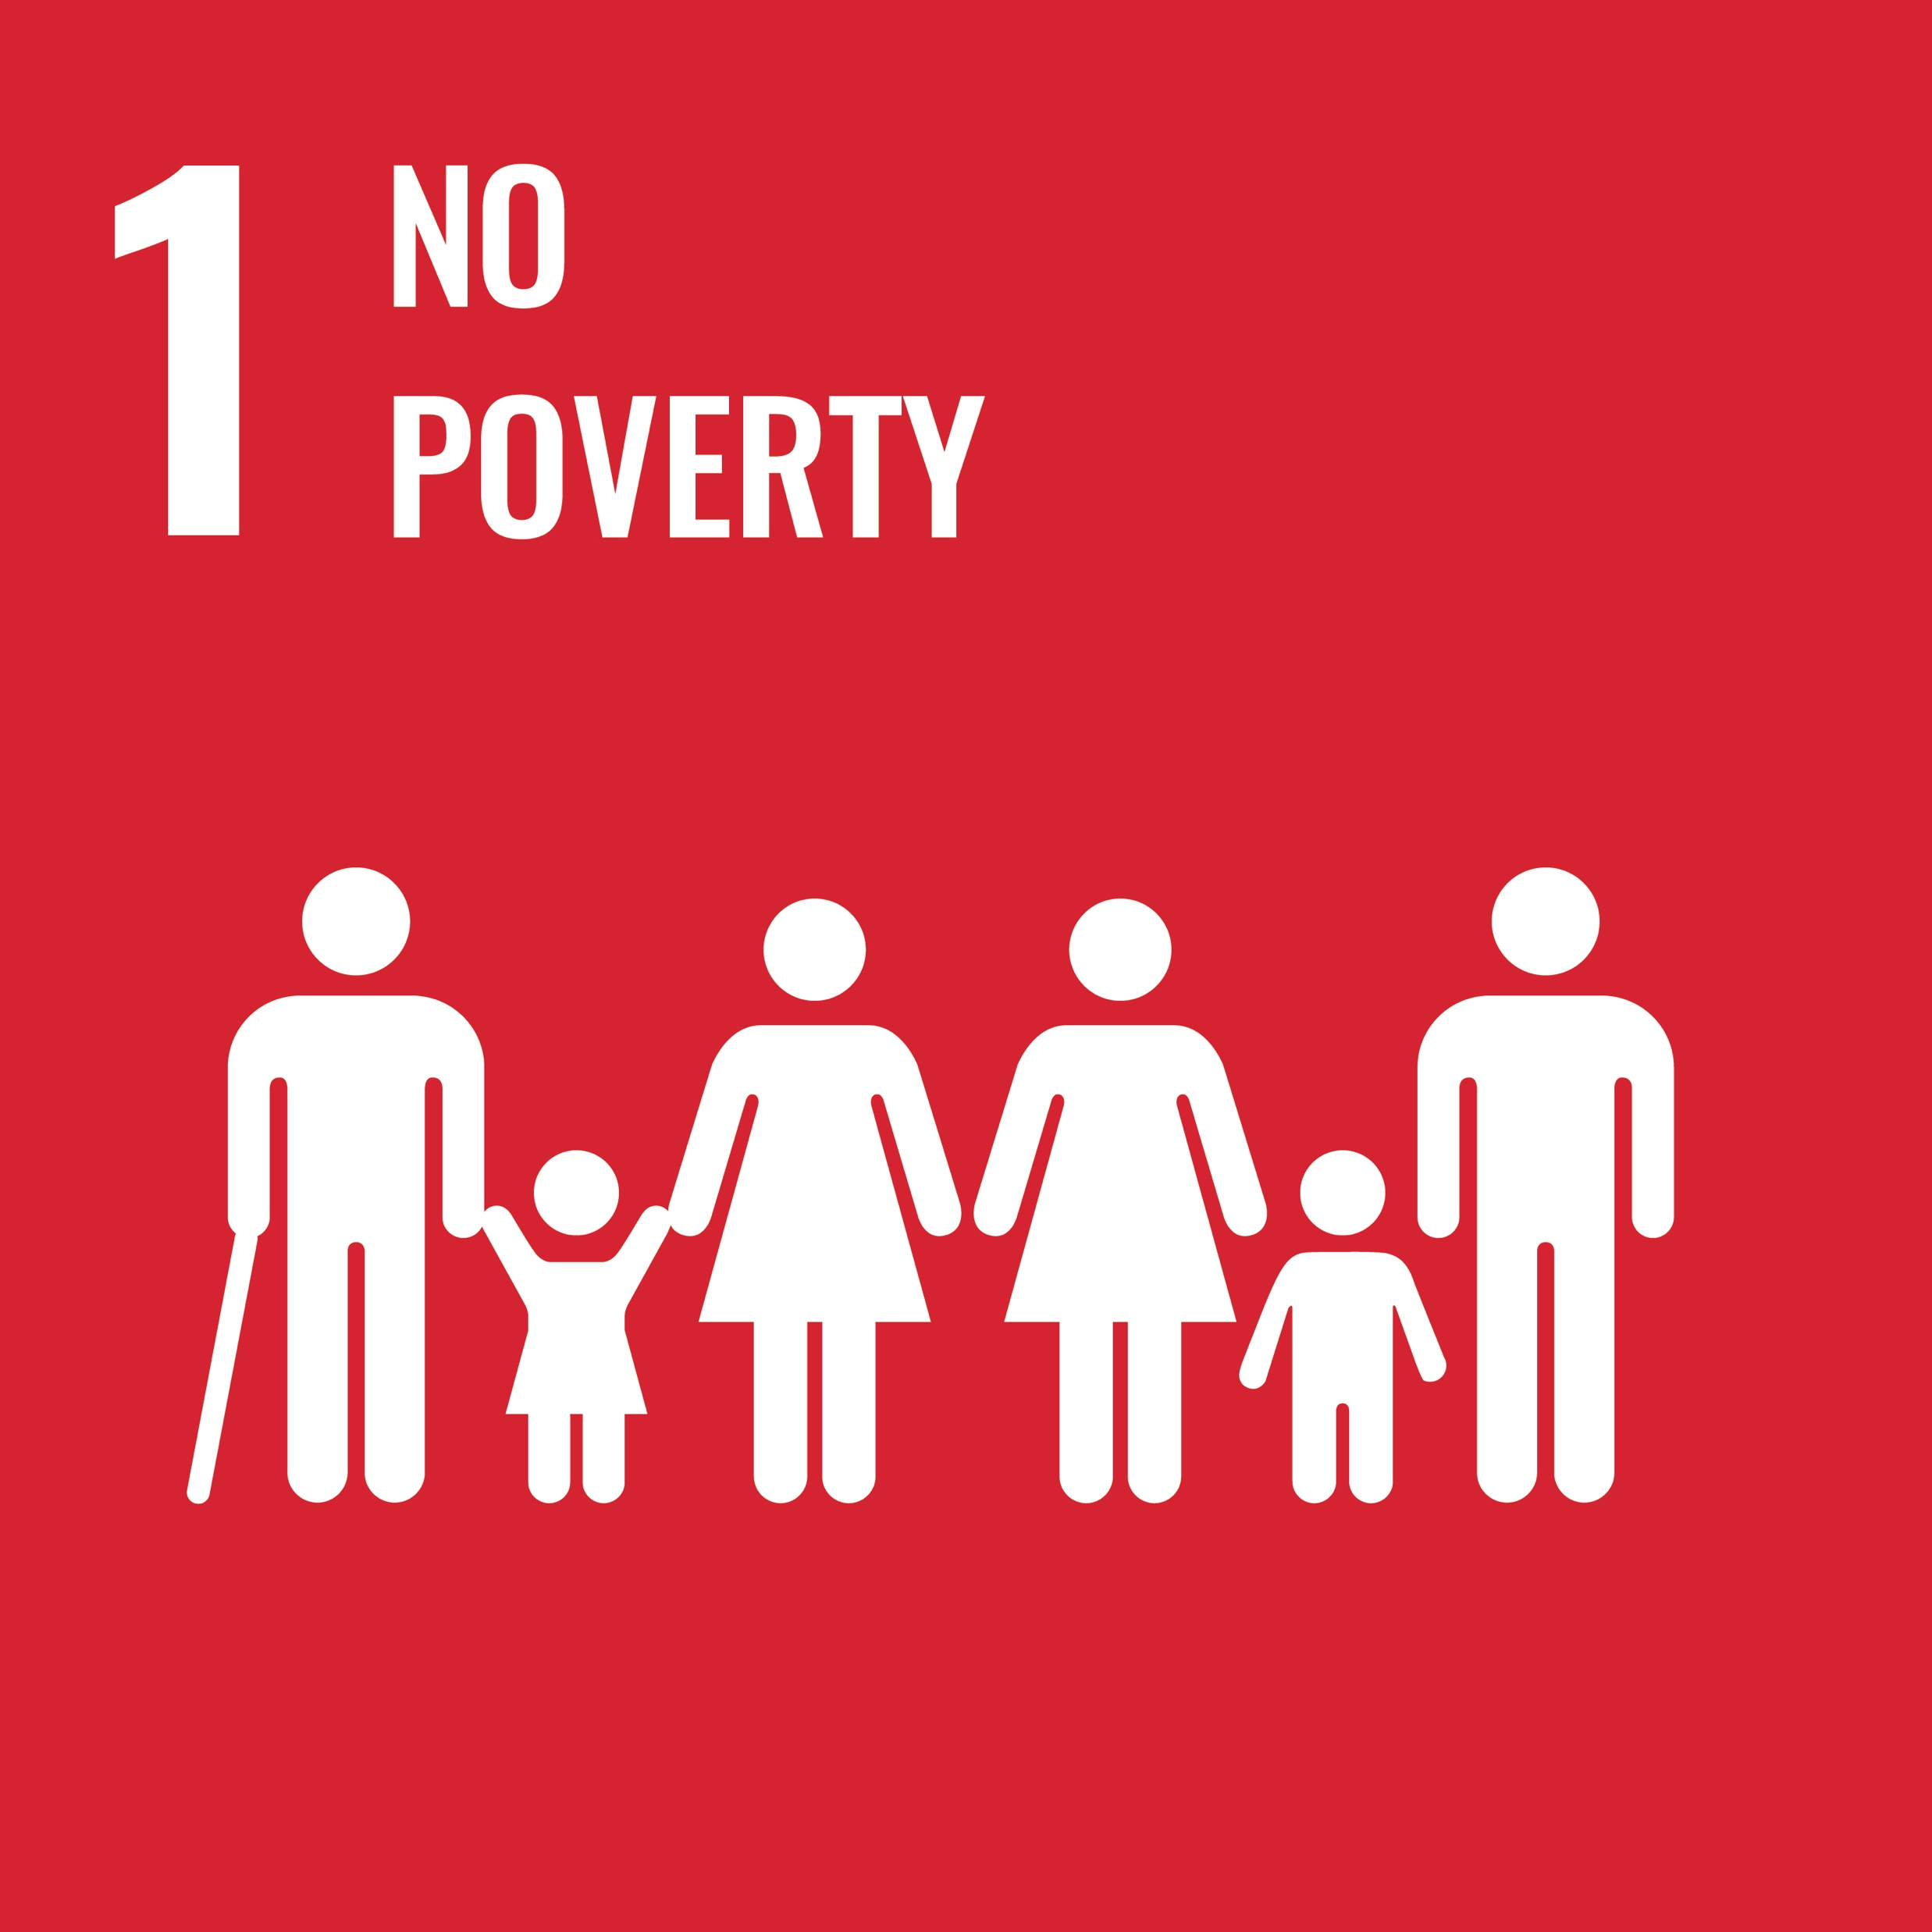
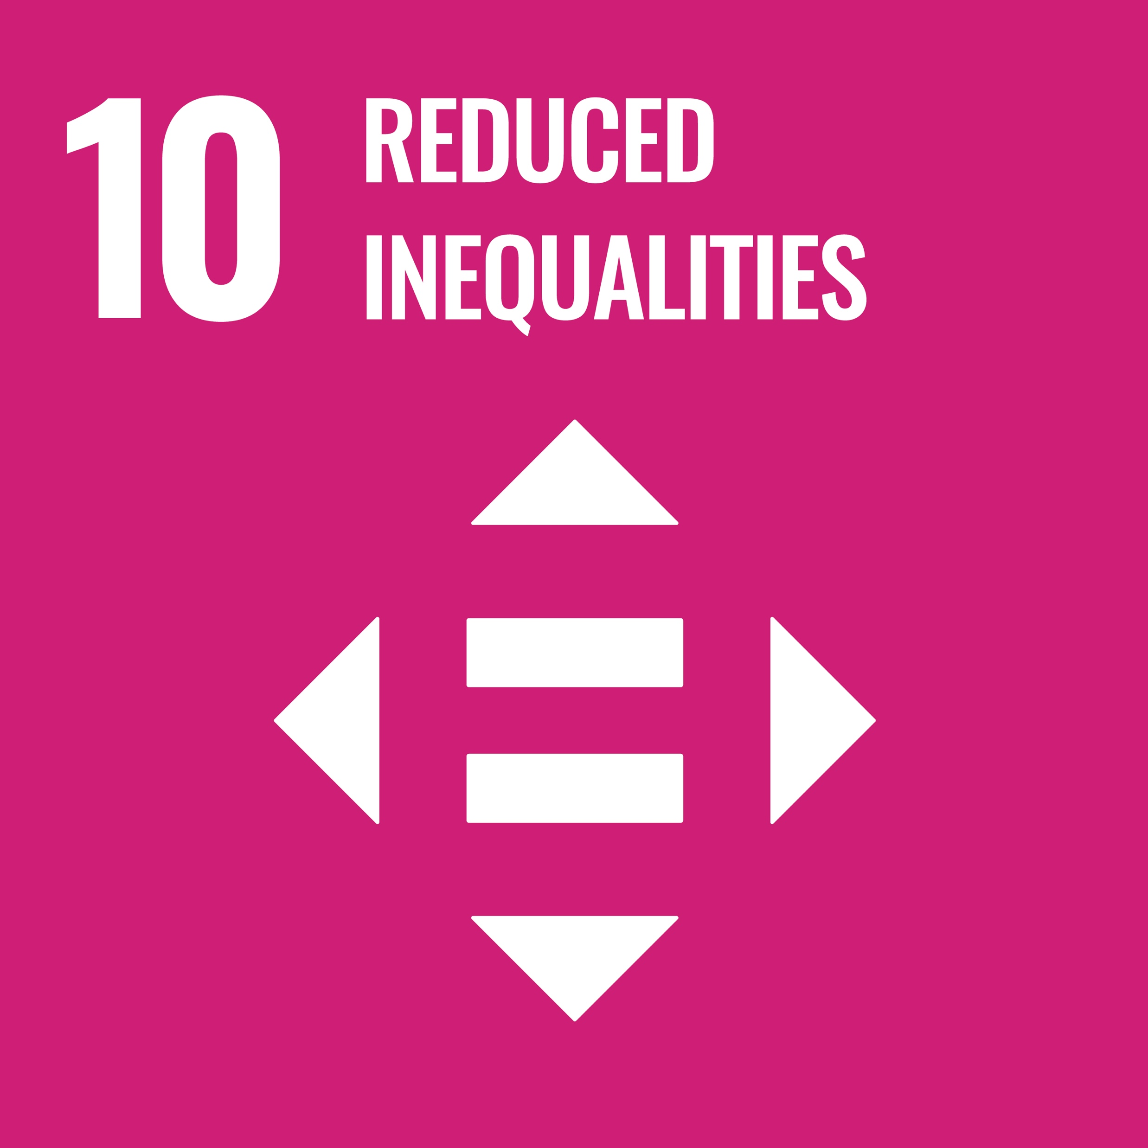

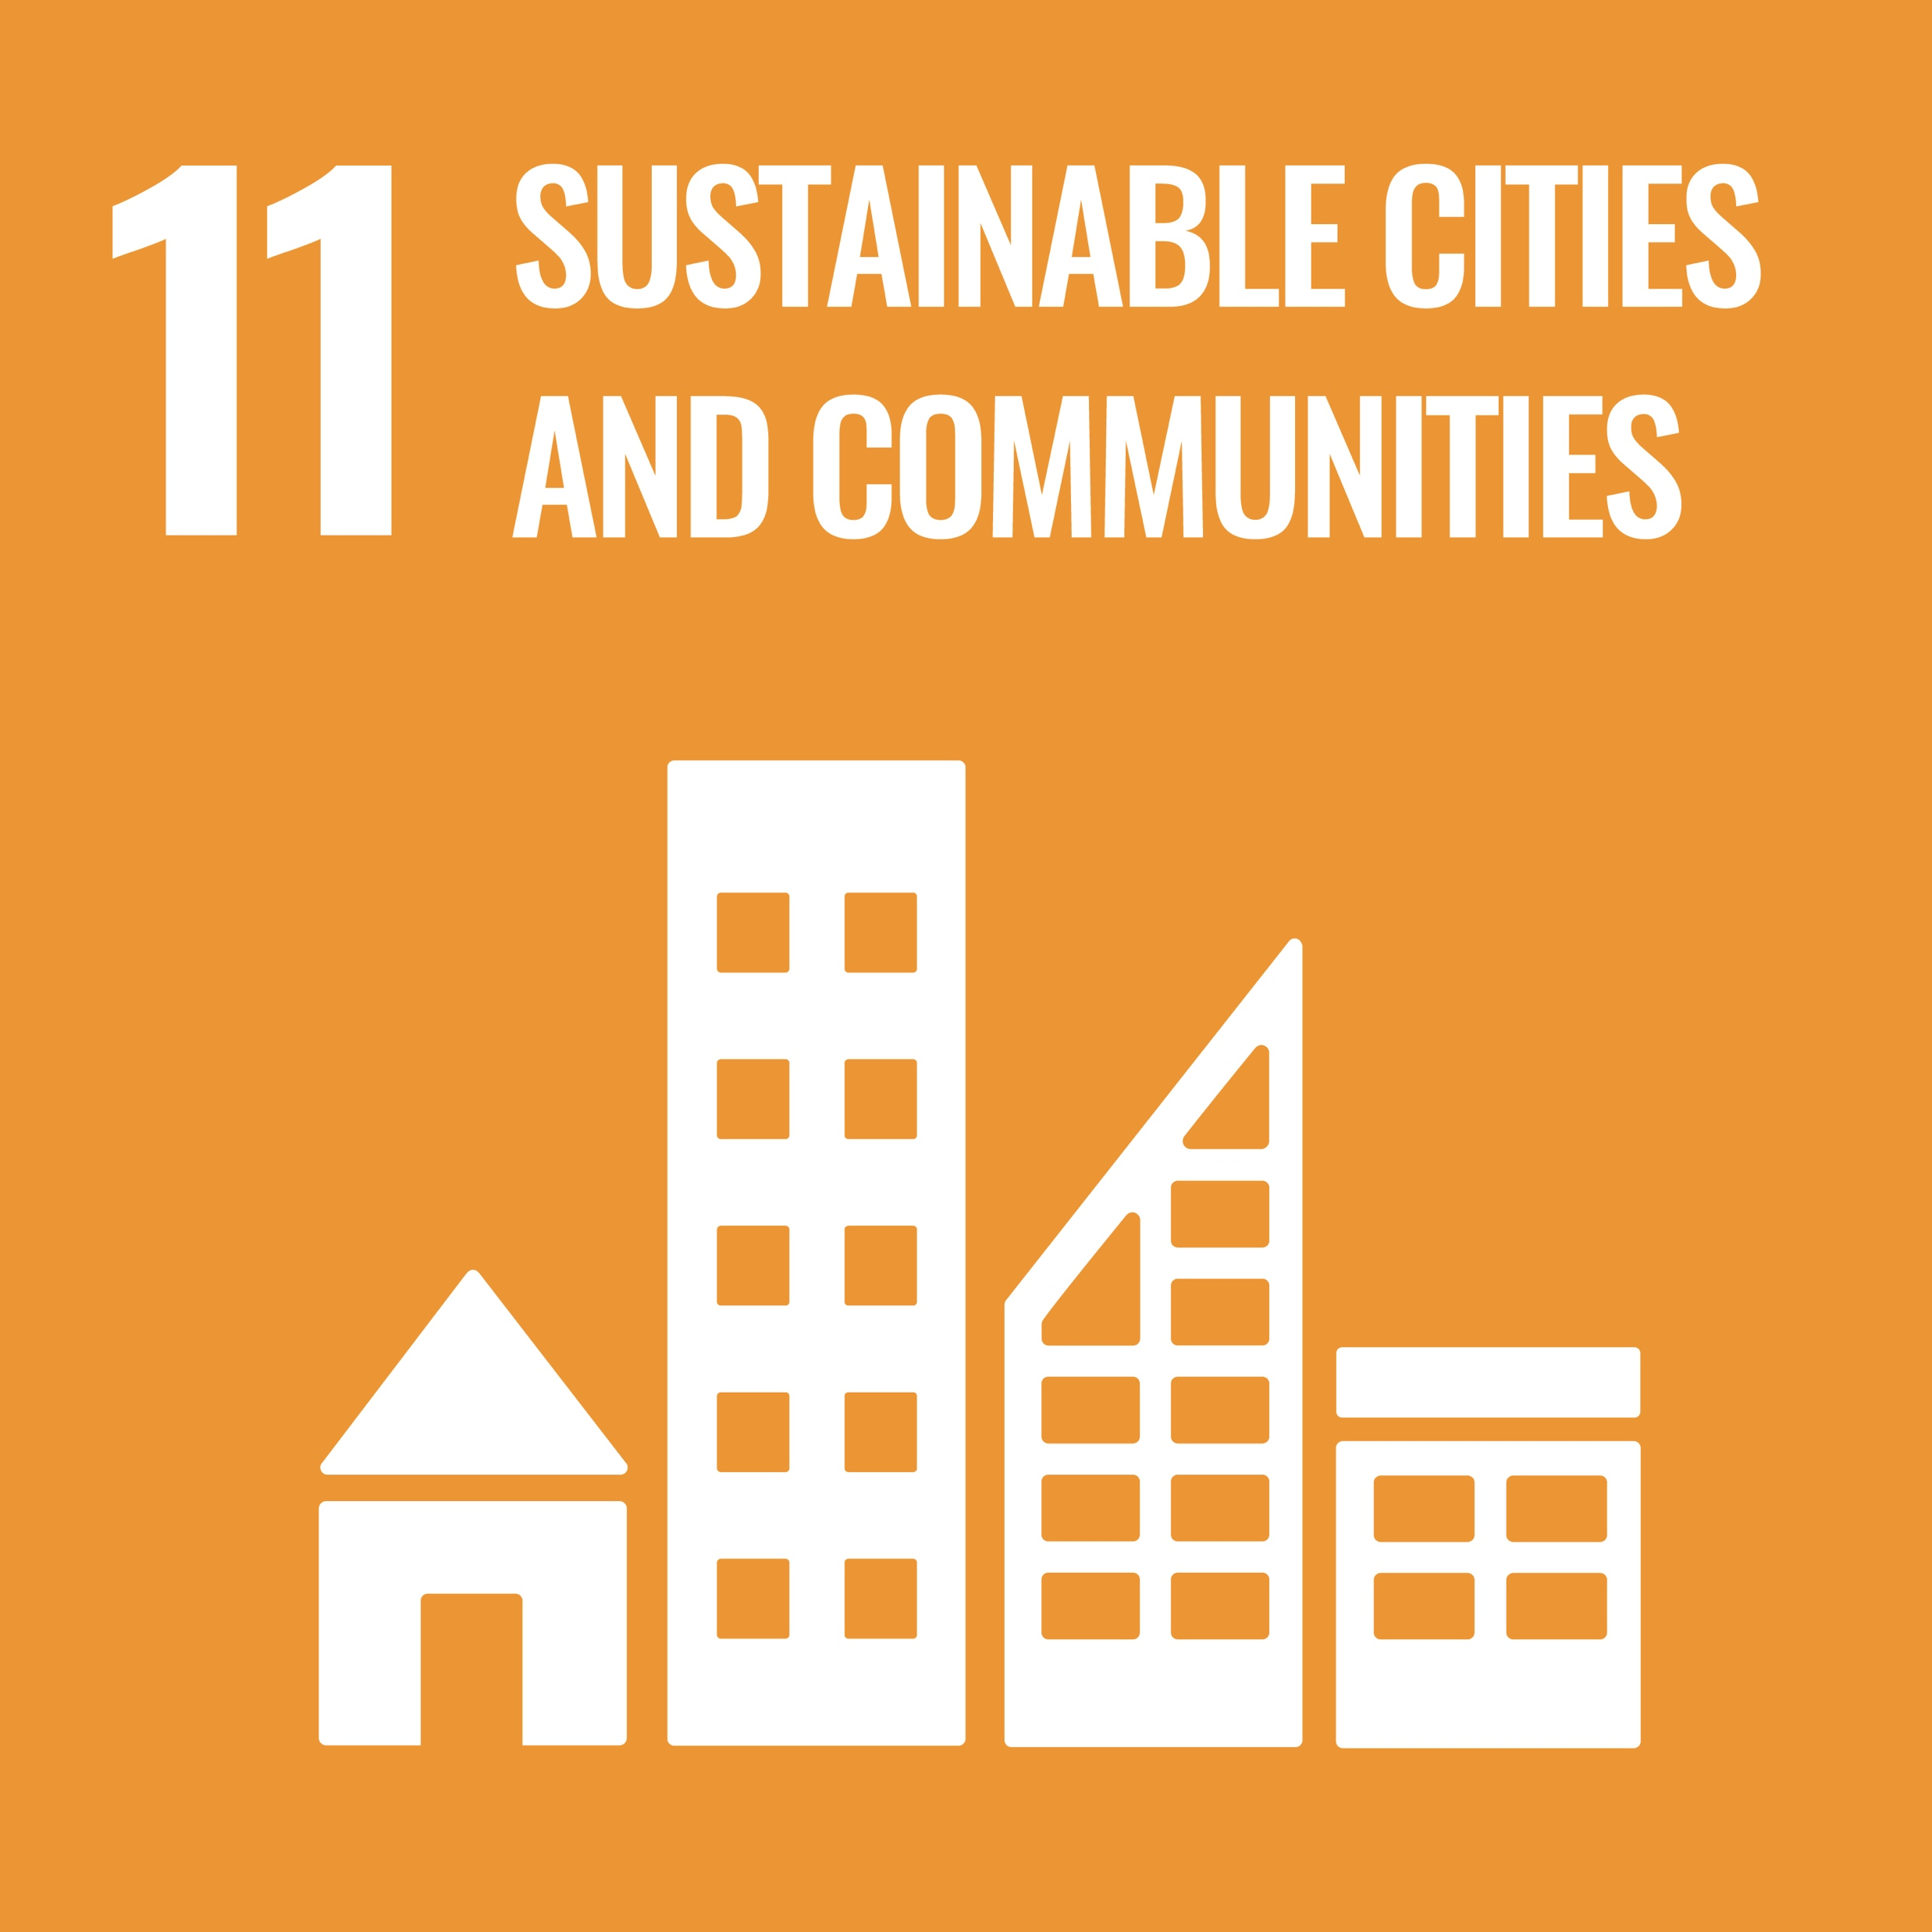

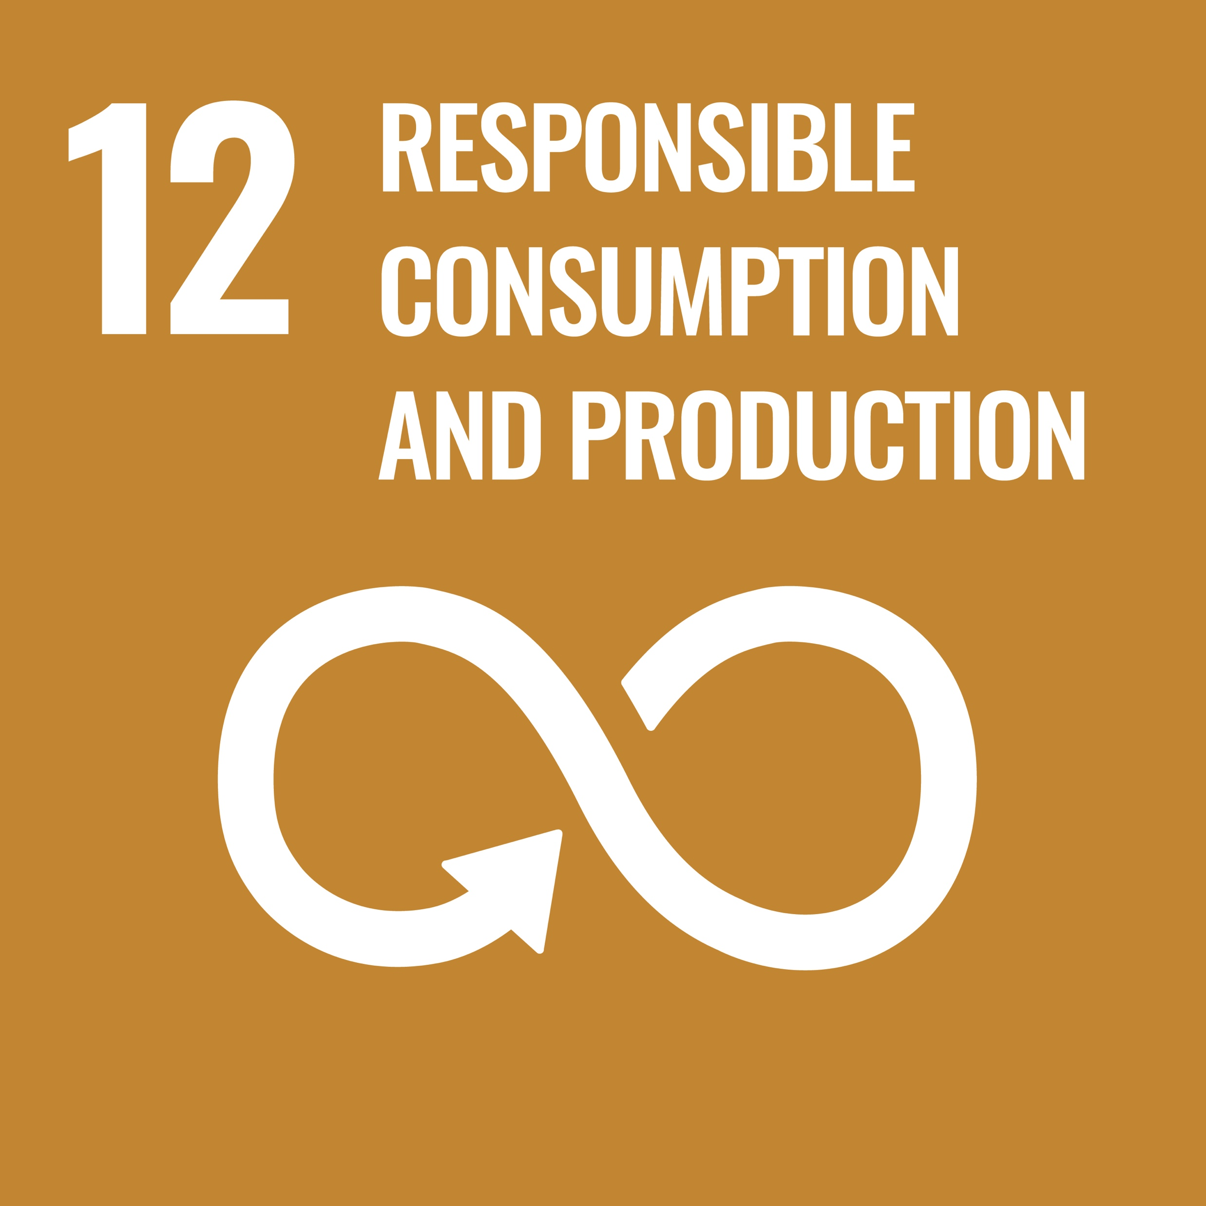



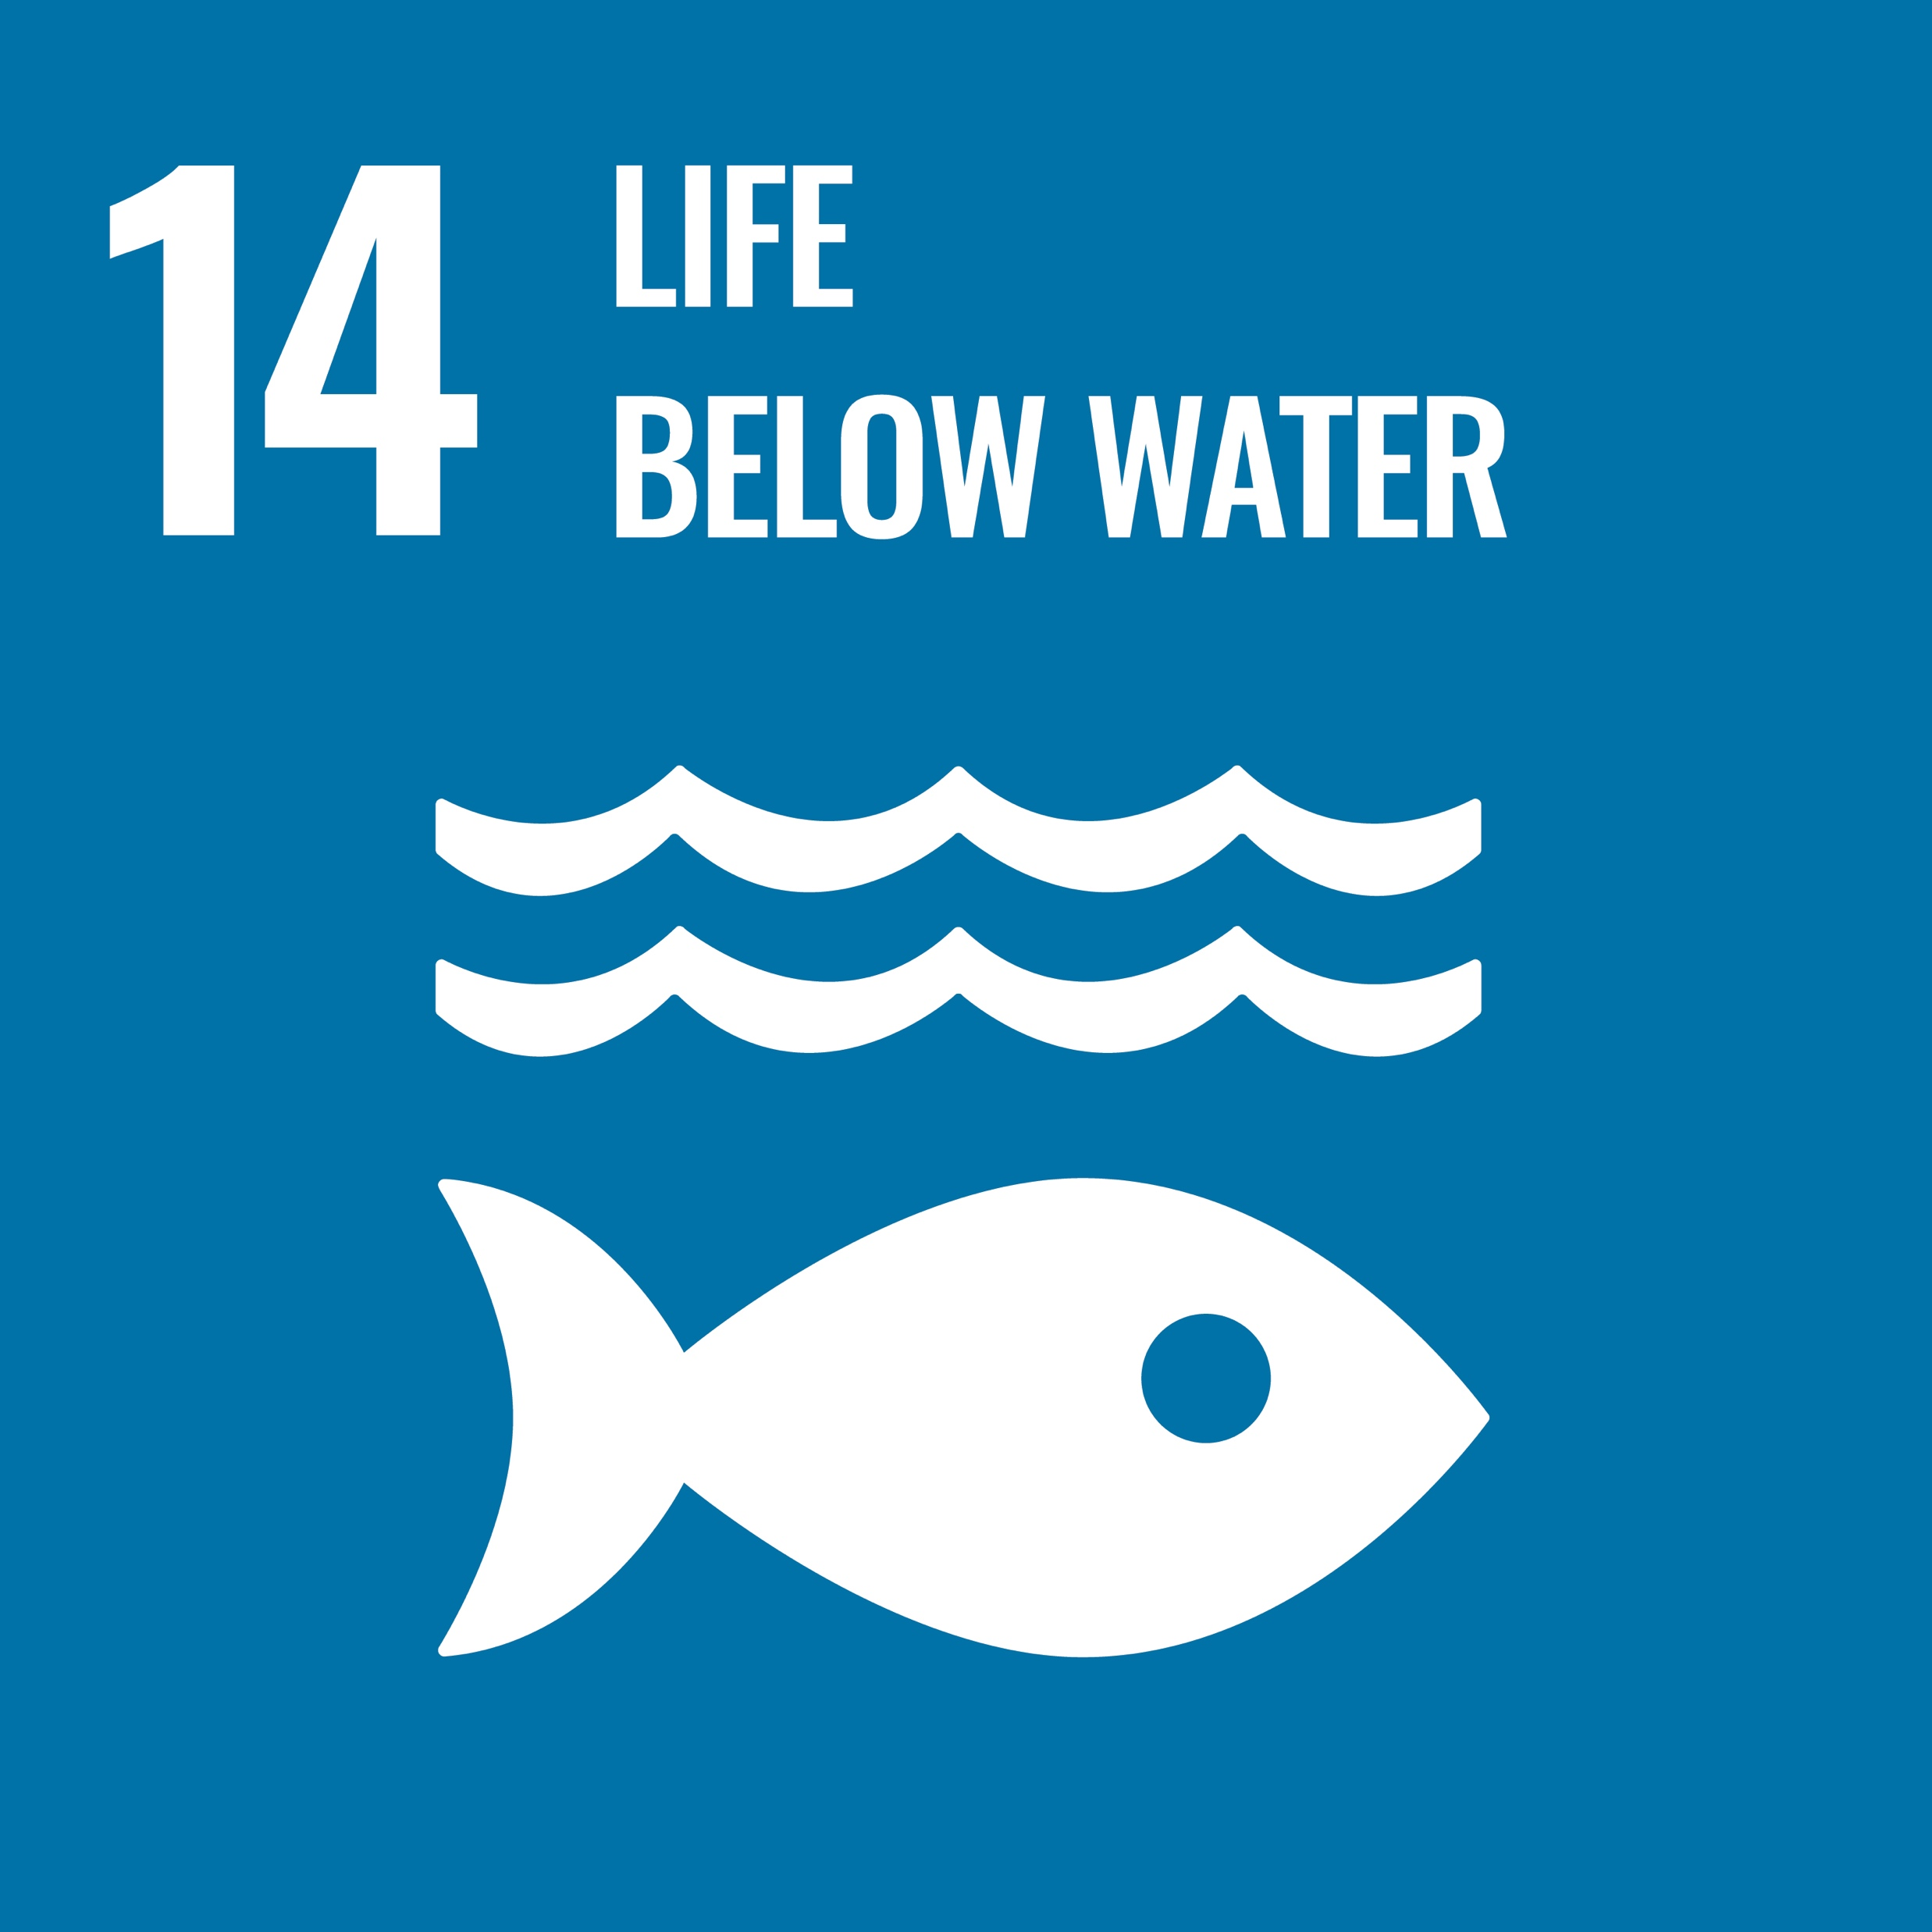
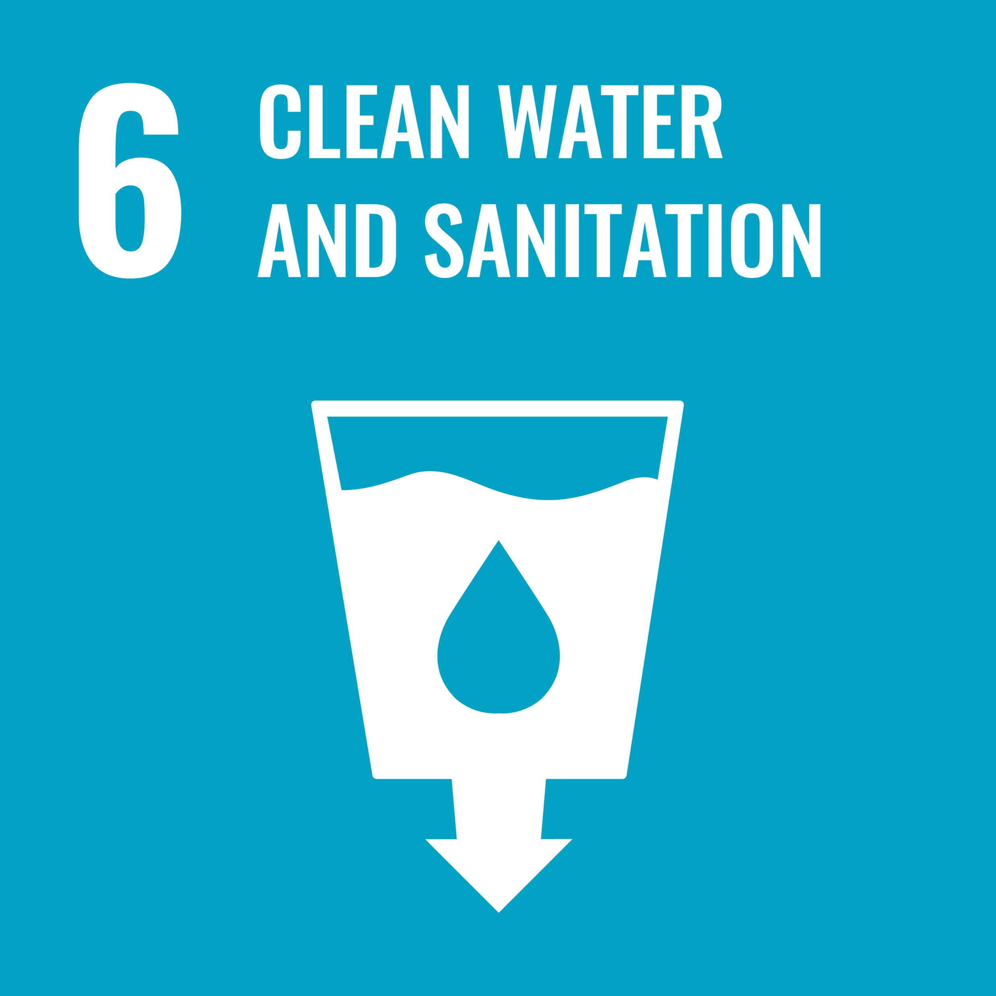

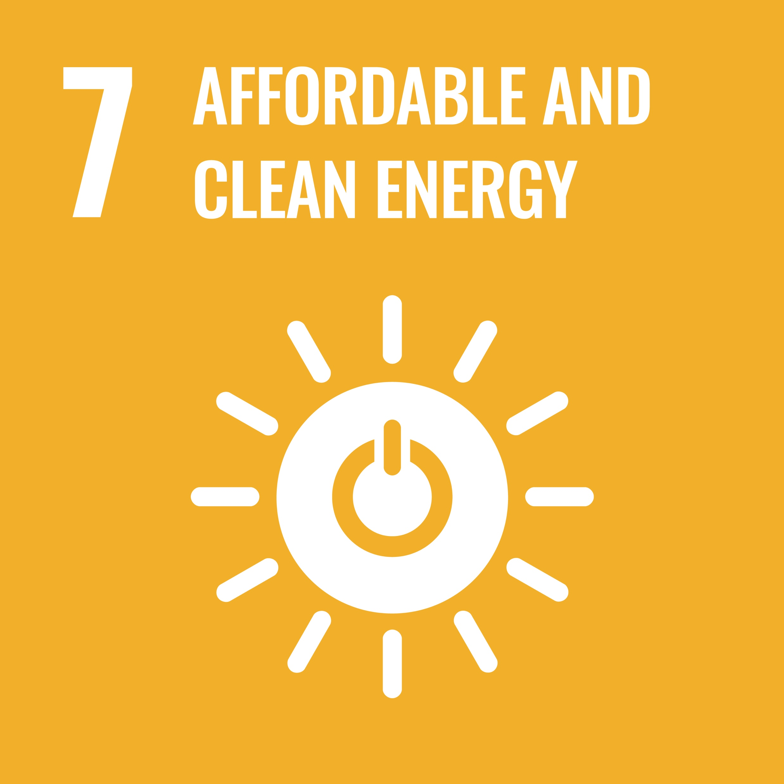

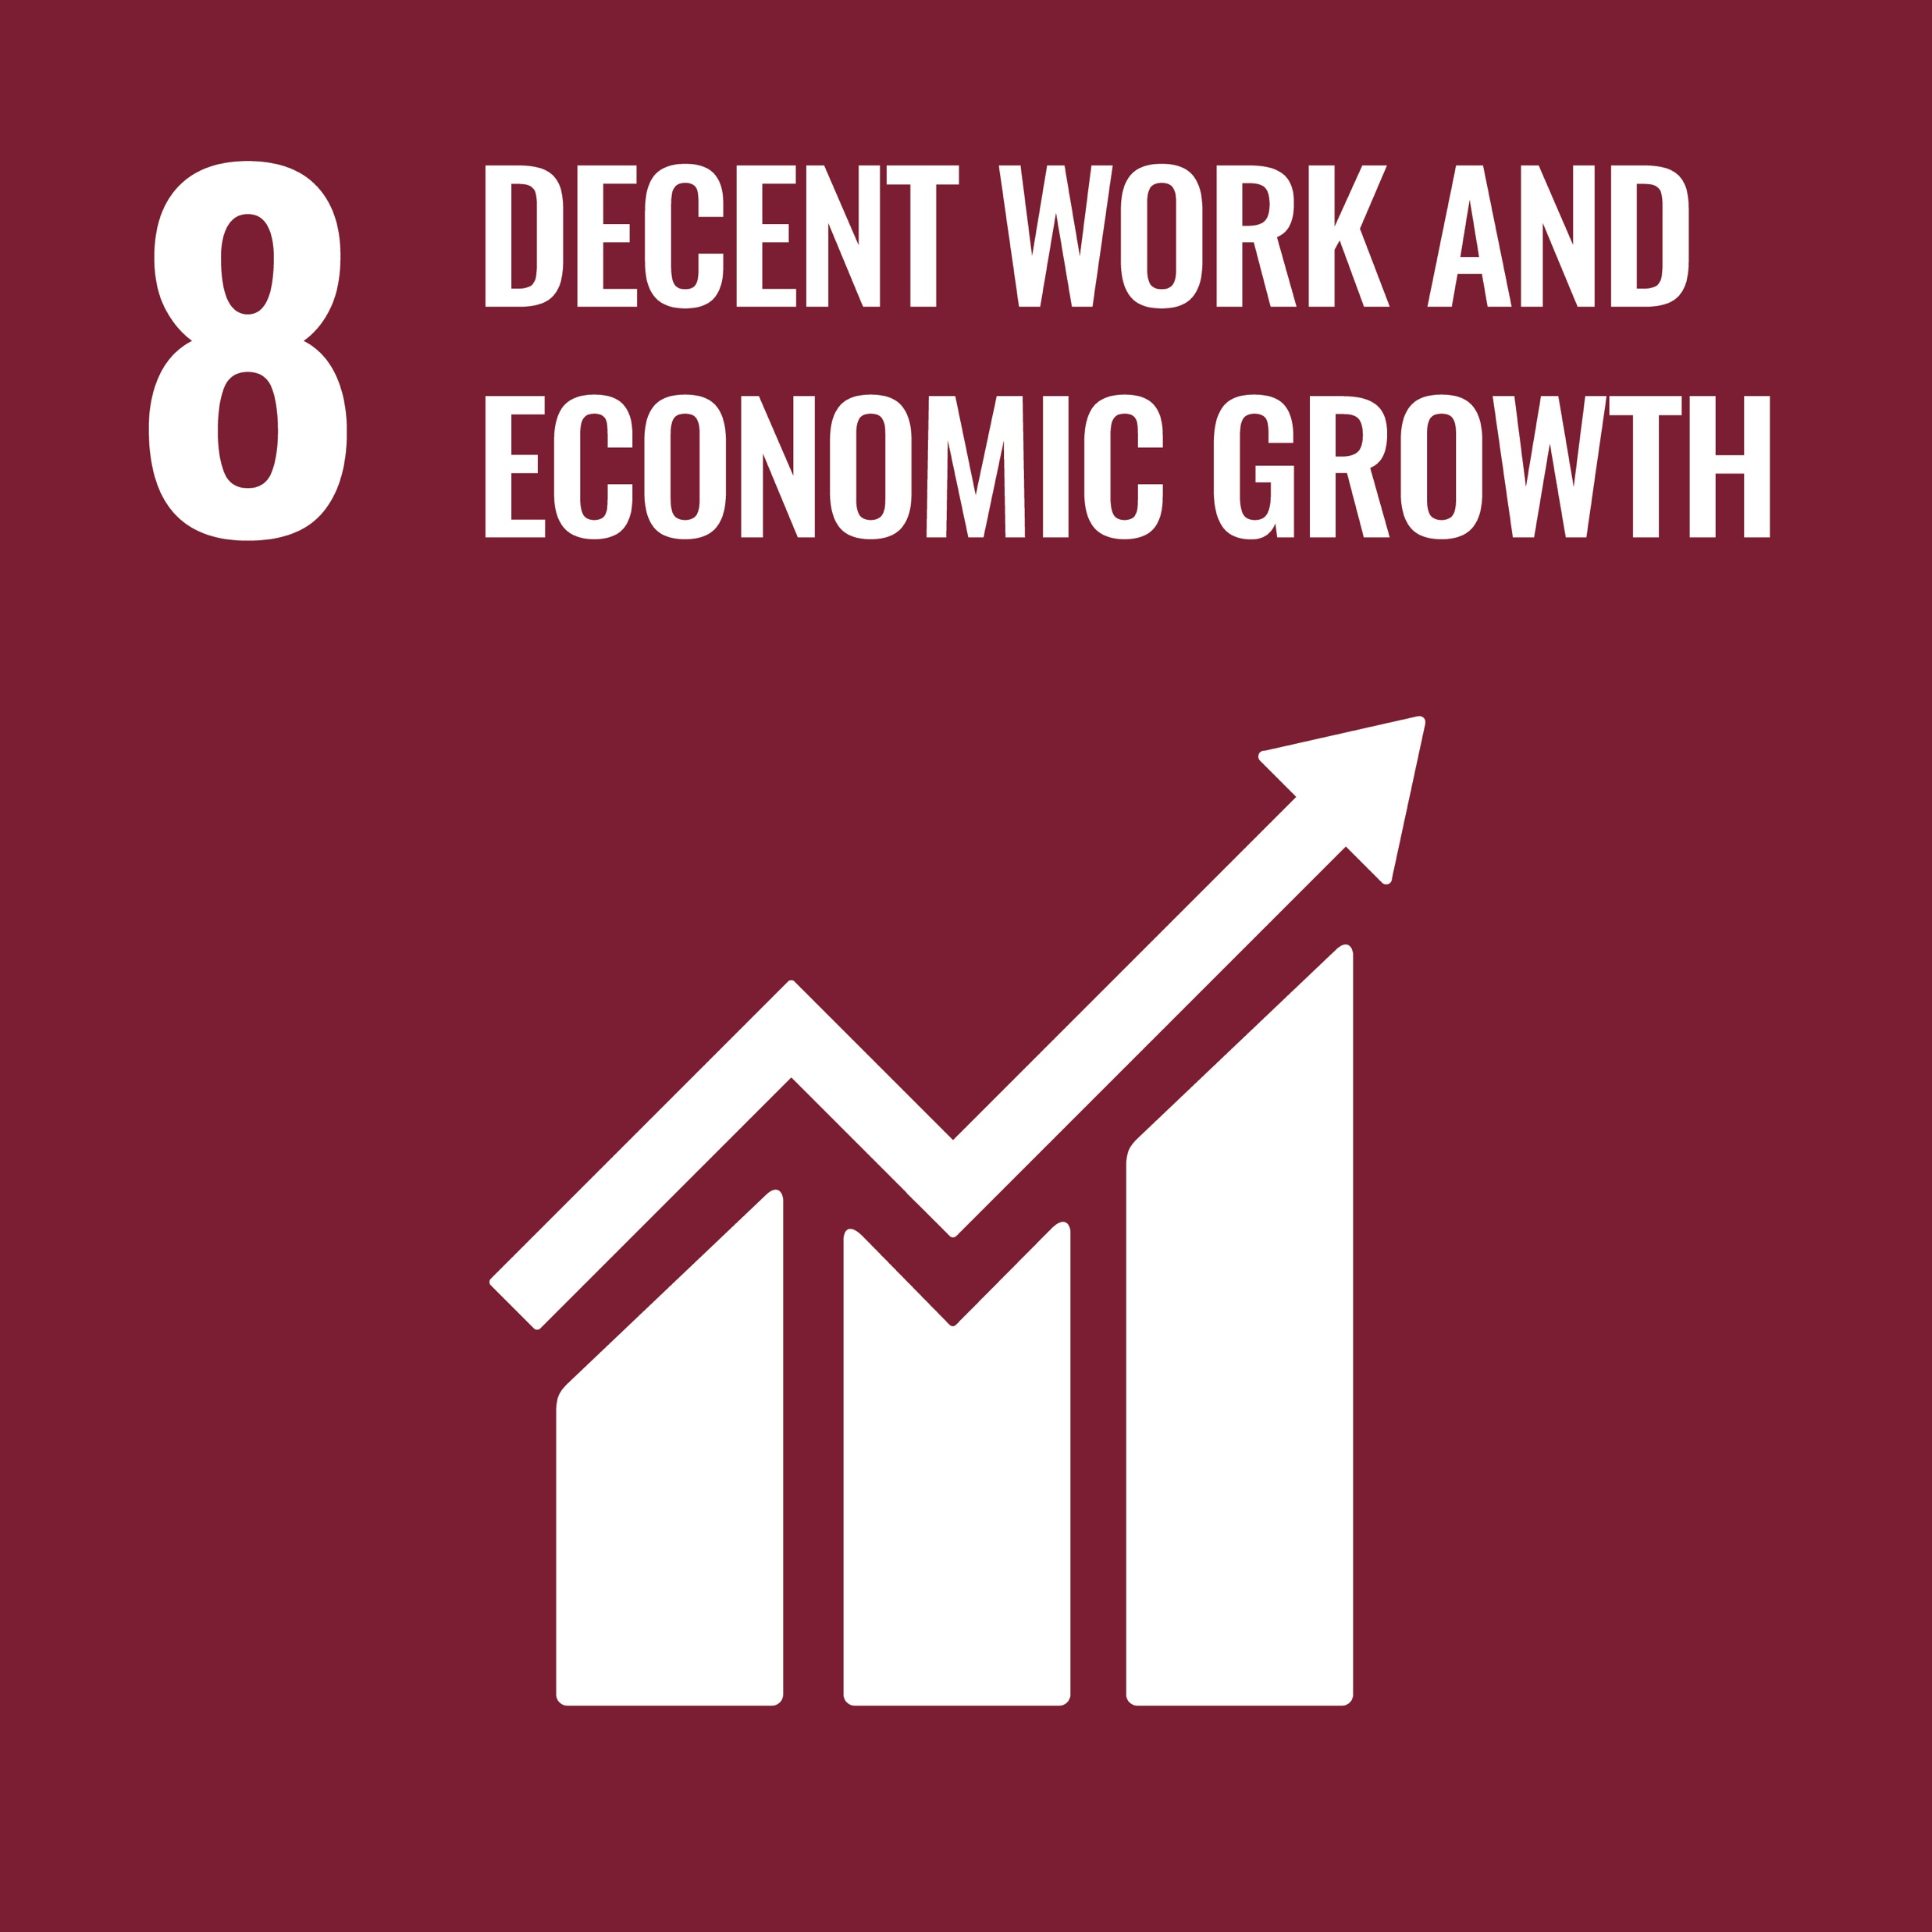

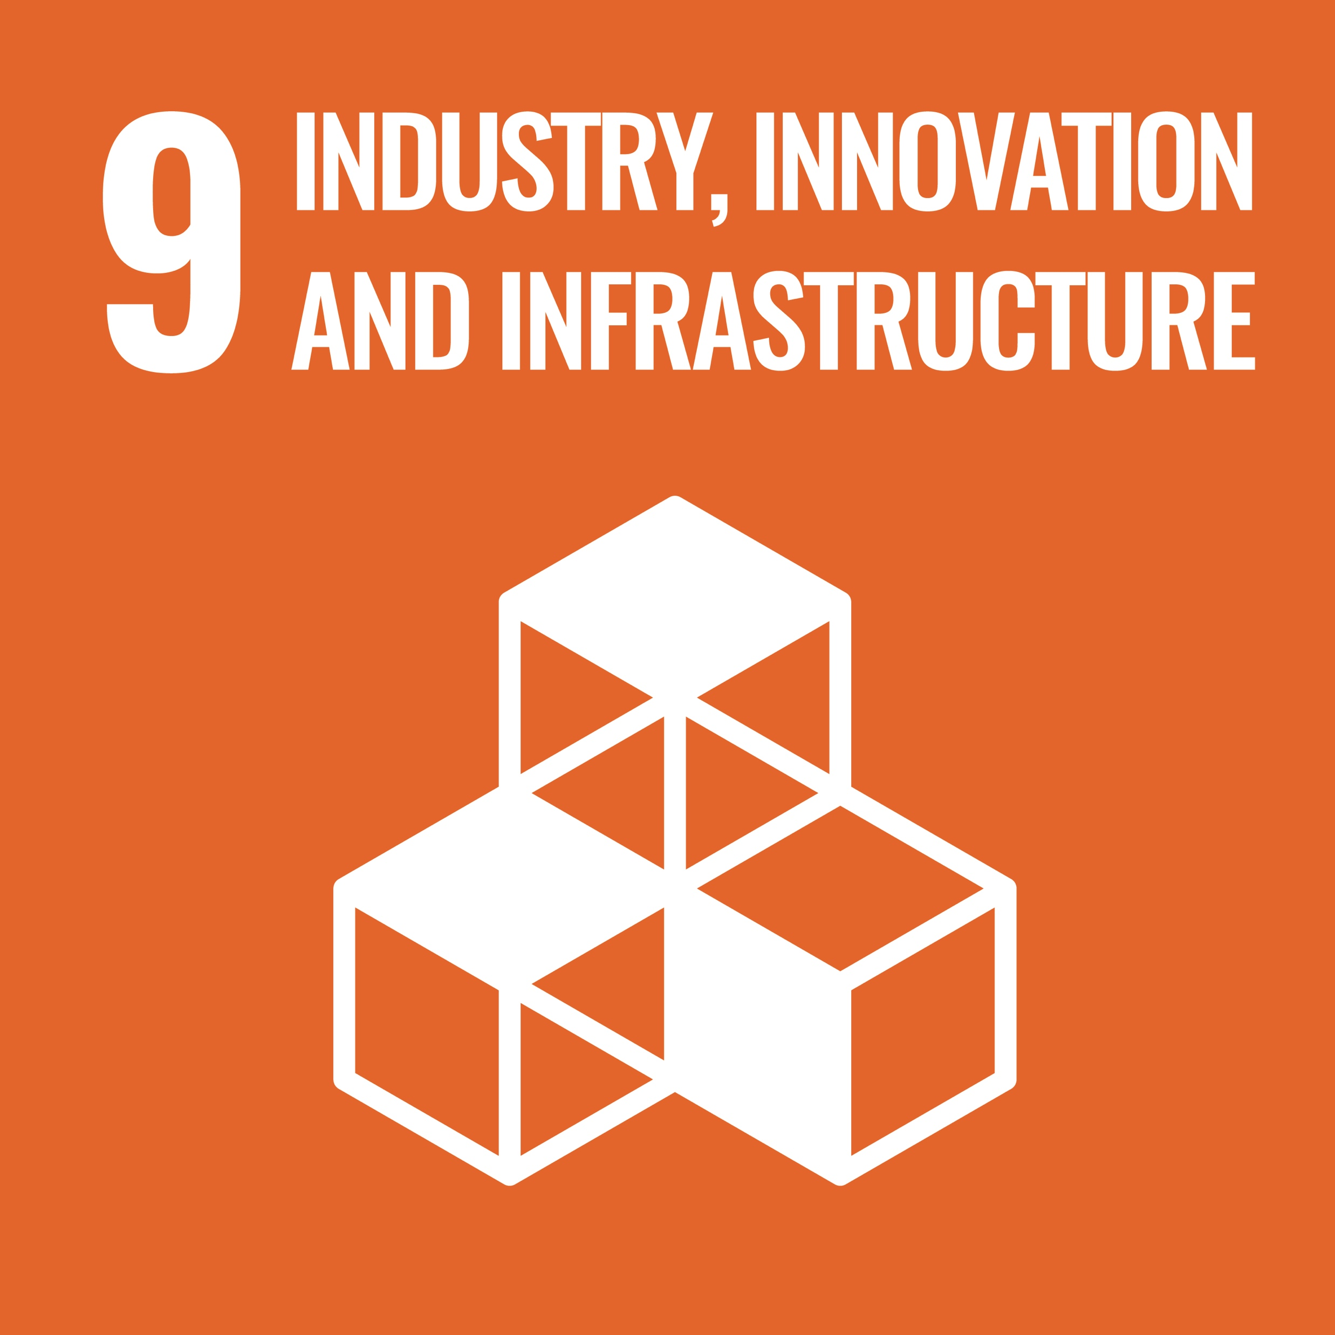
UN Sustainable Development Goal | Potential private sector interactions that foundations can support/ influence via investments | UN Sustainable Development Goal | Potential private sector interactions that foundations can support/ influence via investments
 | Investing in products and services tailored for poor customers (e.g. mobile-based money transfer services for unbanked consumers). |  | Investing in businesses led by under-represented and minority leaders.
 | Investing in solutions providing access to affordable, healthy and nutritious food. |  | Investing in low-carbon transport solutions. Investing in affordable housing.
 | Investing in affordable medicine and health care, including for low-income and other target populations. |  | Investing in innovative closed-loop business models.
 | Investing in facilities, technology and services that provide affordable access to quality education and workforce training for underserved populations. |  | Investing in retrofitting.
 | Encouraging and enabling participation of women in decision-making and governance at all levels and across all business areas (30% or greater). |  | Discouraging/ prohibiting practices that put marine species and resources at further risk of harm, exploitation or depletion.
 | Investing in water and sanitation projects or infrastructure in underserved regions. |  | Investing in sustainable forestry.
 | Investing in local renewable infrastructure to establish accessible energy services. |  | Complying with laws and seeking to meet international standards and requiring partners, managers, advisers, investees etc. to do the same.
 | Investing in businesses with strong apprenticeship opportunities, skills development programmes and fair wage practices. |  | Investing in emerging/ developing markets to promote/ increase the exports of developing countries.
 | Investing in new, resilient infrastructure or retrofitting existing infrastructure to make it more sustainable.
Investable strategies using the UN SDGS
Notes:
Another powerful way of mapping potential investments is against the United Nations Sustainable development goals.
On the screen you can see examples of investable opportunities to support each goal. You may want to think about your mission in terms of the SDGs.

Slide 14



3. Reputational considerations
[Insert logo here]
Ensure that the positive impact created by grants are not diminished by investment activities i.e. that our net-impact across investments and grants is positive
Make investments that can provide comparable risk- adjusted financial returns while increasing the total positive impact created by the foundation
www.impactinvest.org.uk
Notes:
Alongside the positive spurs to deliver impact in the endowment, given climate and biodiversity crises, major inequalities in the world, and racial injustices, there are “pull” drivers too for foundations. Expectations on all organisations are changing with respect to the delivery of social and environmental impacts. Even in 2007 the Gates Foundation was castigated for its investment practices jarring with its public health mission, and the clarion call for foundations to consider the impact of their investments has only become louder.
For example panorama learnt that between 2007 and 2009, some of Comic Relief’s investments, amounting to millions of pounds, appear to contradict several of its core aims. Despite its mission statement claiming it is committed to helping "people affected by conflict", in 2009 the charity had £630,000 invested in shares in weapons firm BAE Systems.
For the average citizen there is a perception gap between what they would assume the majority of a foundation’s assets are delivering, and the reality of them being invested without impact considerations. In a response to a presentation of the US foundation FB Heron’s total impact approach, an audience member asked: “But what were you doing before?”
The general expectation was that as impact organisations, impact would be a consideration in the totality of the organisation as a norm of practice, not the opposite
For some this is a question of what can be described as a charity’s ‘net impact’: if 5% of your total distributable assets are used as grants and are building a better world, but 95% are unwittingly exacerbating environmental degradation, social unrest and inequality – then you may still be broadly ‘net-negative’.
The hope is that by approaching their entire investment portfolio with an impact perspective, charities can not only ensure that the positive impact created by their grants are not diminished by any of their investment activities, but they can also make investments that can provide comparable risk- adjusted financial returns while increasing the total positive impact created by the charity.

Slide 15

4. Catalysing change in other investors and in the capital markets more broadly
[Insert logo here]
Foundations role-modelling positive impact and delivering on their commercial goals can inspire others to adopt the strategy
Impact investing in the endowment increases the possibility of influencing other private sector investors to adopt our impact goals: aligning, coordinating or blending funds
www.impactinvest.org.uk
Notes:
Capital markets have a clear and important role to play in delivering progress on key sustainability issues like climate and inequality. But they are slow to change.
Charities have an opportunity to be role models for other less mission-driven capital market actors. By demonstrating that charities can engage in positive impact investment whilst delivering on their commercial goals, foundations can inspire others to help drive a broader capital markets transition.
Additionally, taking the decision to engage in impact investment in the endowment opens up the prospect of more actively influencing other private sector investors to deliver mission-aligned investment. Alignment, coordination and even blending funds with other investors in the service of social and environmental outcomes becomes more possible in a space where impact is part of the discussion within the endowment. Foundations have an independence and reputational heft that enable them to convene investors that might not normally connect. Deploying that convening power in step with the weight of the endowment is likely to encourage private sector capital flows into foundation priorities. There’s a good example in the Institute guide of an Australian construction worker pension fund investing in affordable housing in partnership with a local government player, and actively influencing others to adopt the strategy and increase affordable housing.

Slide 16

5. Improving the long-term effectiveness and accountability of capital
[Insert logo here]
Foundations generally have a long-term time horizon and thus must grapple with systemic risks e.g. climate change, social inequality
Get on the front foot through impact: spot negative social and environmental issues before they arise and be on the right side of regulatory development
www.impactinvest.org.uk
Notes:
Foundations generally have a long-term time horizon, with most seeking to exist in perpetuity, and only a few spending down their endowments. This focus on the long term means foundations increasingly must grapple with the systemic risks posed by factors such as climate change and social inequality.
Today these risks are not only known but are also financially material with well-documented evidence that social and environmental issues including climate change, poor supply chain practices, diversity and inclusion, farm animal welfare and human health can have adverse financial impacts.
The regulatory environment is responding to these risks, for example through the Taskforce for Climate-related Financial Disclosure (TCFD) and the Modern Slavery Act.
Measurement and reporting practices are core to impact investing. By definition then, delivering an impact investment approach in the endowment will help foundations better understand the extent of their negative and positive impact on people and the planet, anticipate regulatory change and proactively tackle the financial risks presented by the climate and environmental issues mentioned above.
In other words, impact investing in the endowment gets investment managers on the front foot: spotting negative social and environmental issues before they arise and being on the right side of regulatory development.

Slide 17

Getting started: impact investing in the endowment
Obtain an internal mandate for impact investing
Establish financial and impact requirements for the endowment
Update the Investment Policy Statement
Integrate impact and investment at board and staff level to deliver the strategy
Appoint investment advisors and managers with expertise in impact
Notes:
So given this opportunity, how can you get started?
This too we frame as a 5-step process:

Slide 18

Step 1: Obtain an internal mandate for impact investing
[Insert logo here]
Bring together stakeholders from across the staff and board
Information sharing, consultation and education are key parts of the process
Learn from the experiences of other foundations
Start with a small mandate and grow
www.impactinvest.org.uk
Notes:
Obtain an internal mandate: This session is very much part of this process. Every area of the organization having a clear understanding of what impact investing is, what it could mean for the foundation and their shared interest in doing it.
A typical approach to this area is experimentation and learning through doing. Impact investing is a new approach for most, and thus obtaining a mandate for a small percentage of the endowment to be invested under impact principles, or a specified quantum with which to do deals is advised.
This is how others are doing it: Esmée Fairbairn Foundation is delivering £10m of endowment capital for impact seeking a risk-adjusted market rate return on a £1.17 bn portfolio. Guy’s and St Thomas’ Foundation started its journey into impact in 2018 with a £30m-£50m or 5% endowment allocation to impact investing. Start small, learn and build from there.

Slide 19

Step 2: Establish financial and impact requirements for the endowment
[Insert logo here]
Be clear on the financial requirements for the foundation, challenge yourselves on liquidity, and thereafter seek to maximise for impact
Consider the foundation's mission and product selection, but also be prepared to consider opportunities outside of mission still delivering public benefit
Discuss impact goals with investment advisors / managers using common frameworks like the SDGs
www.impactinvest.org.uk
Notes:
Having achieved a mandate to do this work it is important to be clear on both the financial and impact requirements under consideration. And we’d advise starting with financial needs.
Grant-making foundations are making money to serve the ultimate goals of the organisation to make grants to other charities. An intent to pursue those goals will ladder back to establishing the amount of money needed each year to fund grant-making and other activities, combined with whatever the aspiration is for the endowment itself (i.e. without reducing total investable assets or having an interest in growing the endowment or spending down the endowment over a particular length of time).
One roadmap is as follows:
Set a financial goal tied to the foundation’s cashflow: What are the financial needs the foundation has, and how does the endowment need to serve them? A foundation might be happy with 3% + inflation (e.g CPI) to fund 2% grant- making and grow an evergreen asset base for example, but that investment goal needs to be made explicit from the start.
Determine the foundation’s liquidity needs: Most endowments default to a liquid portfolio out of habit and norm, investing predominantly in public securities. Delivering an impact investing approach is strengthened by being open to private markets opportunities as that expands the investable universe. To counter this, foundations can flip the liquidity onus, that is, be comfortable that anything that it doesn’t explicitly need to be liquid can be invested in illiquid assets.
Once the cash flow and liquidity needs have been established for the foundation, you can start to populate portfolios seeking to target as much of a portfolio as possible (given liquidity and return needs) in investing in impact companies (often in private markets) and growing them; or funds with strong shareholder engagement and activism
After this broad conceptualisation of the financial goals of the charity and how they might interact with portfolio construction at a general level, the focus can critically return to mission. The impact investing market is growing year by year, and overall – contingent on the breadth of the foundation mission – there is likely to be some impact approach or product that is suitable.
That said, as with any investment strategy, the more restrictions placed on managers the harder it will be to find mission-aligned investments. There are enough impact investment products available to diversify a portfolio, but if a foundation is too strict on theme (except, currently for climate change) the product selection is likely to be too small. Thematic mission-aligned preferences can be included where available and possible, and thereafter the creation of a more generalised public benefit can be a helpful way of thinking about the impacts created. For example, for a foundation with an environmental mission, investments in affordable housing may not directly deliver on its stated mission objective; however, including affordable housing debt in the portfolio would likely be of more public benefit than investing in UK sovereign debt with a similar risk/return profile. If the choice is between mission alignment and no impact investments, or public benefit alignment and some impact investments, the latter strategy clearly generates more positive ‘net-impact’ overall.
When selecting impact goals, common frameworks can be helpful. The UN SDGs are now in common use in the investment community: locating a foundation’s mission among these goals can be a helpful communication bridge between the investment and foundation worlds. Inspiration can also be sought by looking at major trends in sustainable finance – for example natural capital or climate change – to understand the different opportunities in the private sector where finance touches the issues a foundation cares about.

Slide 20

Step 3: Update the Investment Policy Statement
[Insert logo here]
Articulate the foundation's values in the investment policy statement
Highlight impact goals alongside financial goals
www.impactinvest.org.uk
Notes:
The Investment Policy Statement (IPS) is a key document likely requiring change to support the process of shifting towards impact investing. The role of the IPS generally is to communicate the foundation’s parameters on investment performance - risk, return and liquidity – to the professionals that manage these investments.
Updating your IPS to include your impact goals alongside your financial goals facilitates working smoothly and in alignment with your investment advisors and managers. Friends provident has a great example here.

Slide 21

Step 4: Integrate impact and investment at board and staff level to deliver the strategy
[Insert logo here]
Consider diversifying the trustees who sit on the investment committee to include impact specialists
Consider hiring new personnel specifically charged with driving engagement and impact in the endowment
www.impactinvest.org.uk
Notes:
In most foundations - the division between endowment management and grants management in a foundation is often evident in the administrative, governance and human resourcing structures that serve the organisation.
Despite the organisation as a whole being a combination of both finance and impact, in practice the different domains of the foundation are often managed quite separately. To deliver this strategy you need to change that – both at the board and exec level. Particularly important is adding an impact perspective to the investment committee, or even better an impact investing perspective. At the team level, new personnel may be required beyond the financial director of the foundation, who are specifically charged with driving engagement and impact in the endowment. In all of the foundations featured as case studies for the Institute, from Treebeard at £20m to Esmée Fairbairn at over £1bn, there was a key individual hired to challenge, provoke and oversee the impact side of the investment strategy. For those however that are resource constrained and can’t add headcount to deliver this strategy, a good investment manager, adept at impact and with a strong client ethos, can be sufficient to support a strategy.

Slide 22

Step 5: Appoint investment advisors and managers with expertise in impact
[Insert logo here]
The relationship between the foundation and manager is where an impact investing strategy lives or dies
Work with existing managers to develop the strategy: consider running a selection process to obtain new management if current managers are not supportive of your impact investing ambitions
www.impactinvest.org.uk
Notes:
It is often in the relationship between the foundation and manager that an impact investing strategy lives or dies. If a foundation is convinced on the approach, but their investment manager or advisor is not well-versed in impact investing, it will not fly. Good partners are out there. The institute has seen mainstream managers with strong impact practices as well as specialist asset managers with a deep understanding of the field.
Presented with an investment manager partner that doesn’t understand the field as adeptly as these players, a foundation is likely presented with one main course of action: run a selection process to obtain new management that can help to invest for impact. Both Ufi VocTech Trust and Access have run and publicly documented the process they went through to appoint an investment manager that could support impact investing.
Another interesting approach taken by Friends Provident Foundation, Blagrave Trust and Joffe Trust in 2020, and Eiris in 2021 is to go yet further on transparency, running an open tender process for new investment managers. This process, where investment managers pitch publicly to win a mandate while the foundation in question considers their responses but also invites others to hear the presentations, is a very powerful approach. It raises awareness of investment management that delivers impact, and enables comparison between different providers, accelerating the number of managers competing on impact as well as fees and returns.

Slide 23
What could impact investing look like for your foundation?
[Insert logo here]
“
[Insert mission statement here]
www.impactinvest.org.uk

Slide 24

How could impact investing positively help us meet our mission?
[Insert logo here]
[Insert key work areas here]
www.impactinvest.org.uk

Slide 25

Some further questions to consider
[Insert logo here]
What kind of opportunities are out there that directly speak to our mission?
What might we be investing in/are we investing in that could be undermining our mission?
www.impactinvest.org.uk

Slide 26

Annex: The Impact Investing Institute

Slide 27
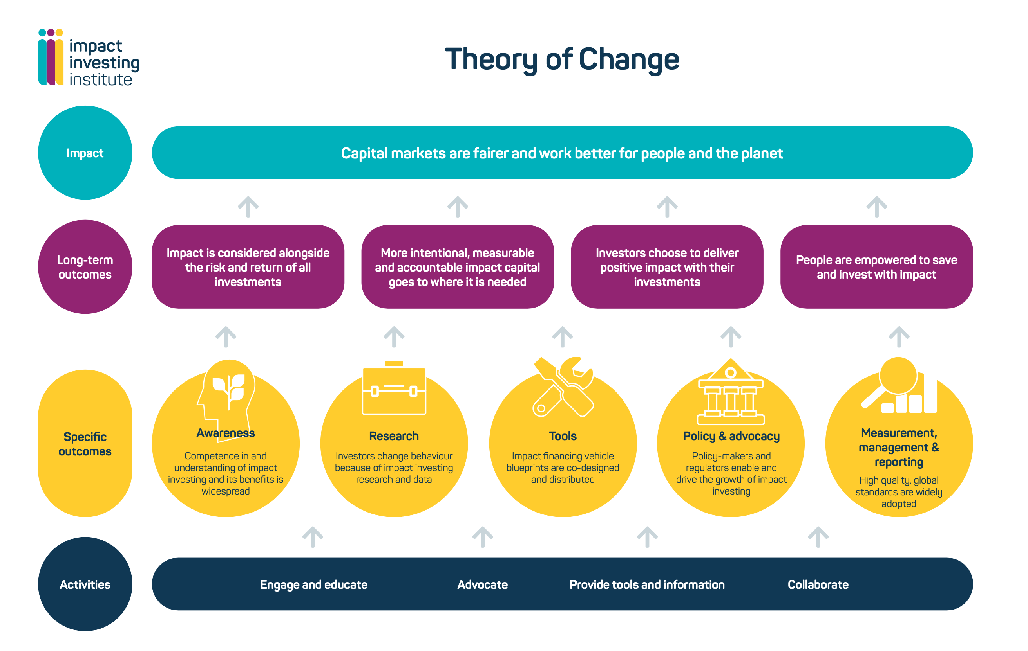
About the Impact Investing Institute
We are an independent,
non-profit organisation
Our mission:
To accelerate the
growth and improve
the effectiveness of
the impact investing market in the UK and internationally.
www.impactinvest.org.uk
Notes:
This presentation has been developed by the Impact Investing Institute:
It is an independent, non-profit organisation seeking to mobilise more private sector capital, at scale, to address social and environmental challenges. It aims to change capital markets - in the UK and internationally – so that they are fairer and work better for people and the planet.
The Institute was founded in 2019 as the confluence of two Government Taskforces on impact investing led by Sir Harvey McGrath and Dame Elizabeth Corley – who today serve as the Chairs of the Institute’s Advisory Council and main board respectively. It is the UK’s National Advisory Board on impact investing.
It’s a field-builder – it doesn’t manage money, It aims to support the impact investing market to grow not only in size but also in effectiveness.
It is supported to do this work by the UK Government, City of London Corporation and 14 financial services firms.

Slide 28

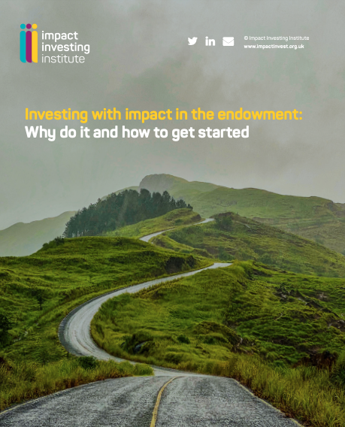
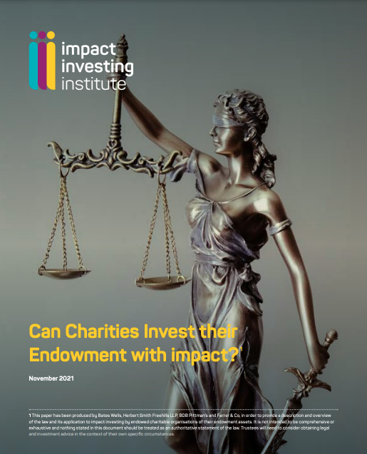




Endowments with impact programme
Goal:
To encourage and enable UK endowed charities to unlock increased public benefits & mission outcomes by delivering impact investing in their endowments.
www.impactinvest.org.uk
Notes:
As an organisation committed to grow the field of impact investing, the Institute focuses much of its attention on big pools of capital yet to allocate for impact. Charitable foundation endowments are (oddly!) one of those groups. Despite philanthropies pioneering the impact investing approach, framing it and participating in the market, endowment activity is still a minority pursuit, and with £72bn AUM in the UK alone in the top 300 UK foundations endowments - that is a huge opportunity.
Supported by DCMS and Esmée Fairbairn foundation the Institute embarked last year on a focus to encourage and enable UK endowed charities to unlock increased public benefits & mission outcomes by delivering impact investing in their endowments.
This work takes place across four strands:
The Institute has:
Created a short legal paper with leading city law firms that demonstrates the ways in which impact investing is compatible with charity trustee responsibilities
Created a practical guide designed to help foundation leaders make their first moves into impact investing.
Created case studies of great practice from foundation peers: Esmée Fairbarin, Guy’s & St Thomas’ Foundation, Treebeard Trust, Ceniarth and Friends Provident Foundation.
And are bringing people together: developing a stakeholder engagement programme across the sector working closely with ACF and others to develop an approach.

Slide 29
Thank you
Contact us
Sophia Omar, Programme Manager
Sophia.omar@impactinvest.org.uk
Find out more about our work with endowments at
impactinvest.org.uk/endowments

